Slide 1


Research update
Lea Herold

Slide 2
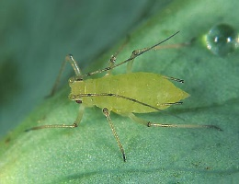
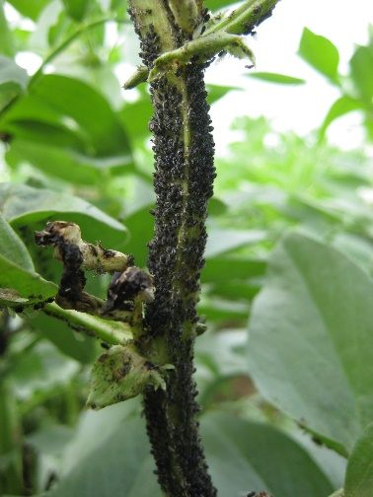
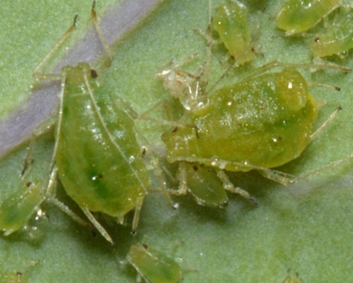
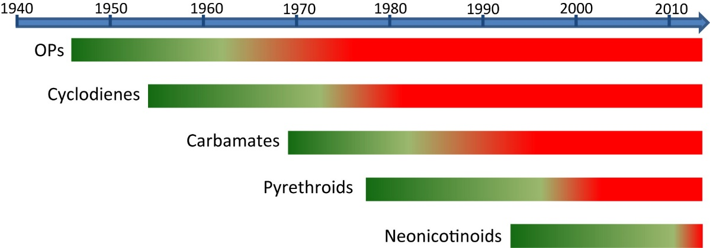
Aphids
Key aphid species:
  Pea aphid – moderate host range, virus vector
  Myzus persicae – wide host range, virus vector, of greater importance in legumes than originally thought
  Black bean aphid – wide host range, feeding damage
Broad resistance Myzus persicae
Anecdotal evidence of pirimicarb resistance in pea and black bean aphids
Timeline of resistance development in M. persicae. Green bars indicate years where insecticides provide good control. Red bars indicate the development of control compromising resistance
Bass et al., 2014

Slide 3
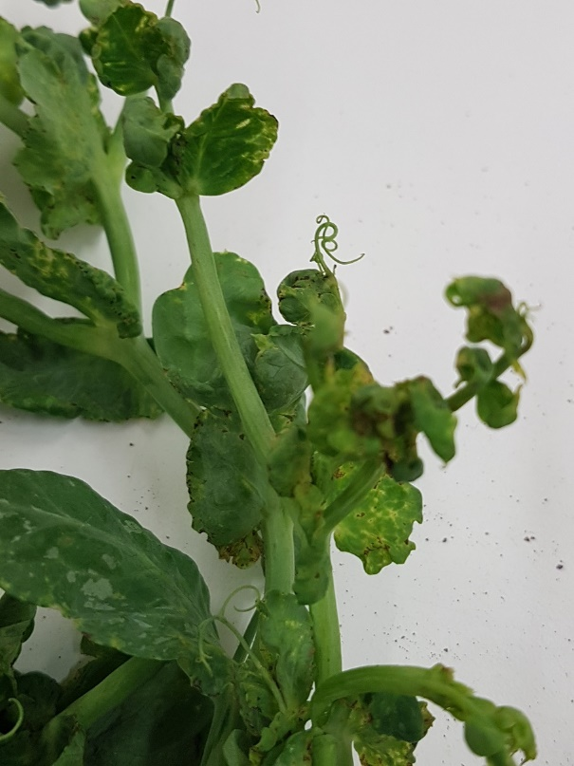
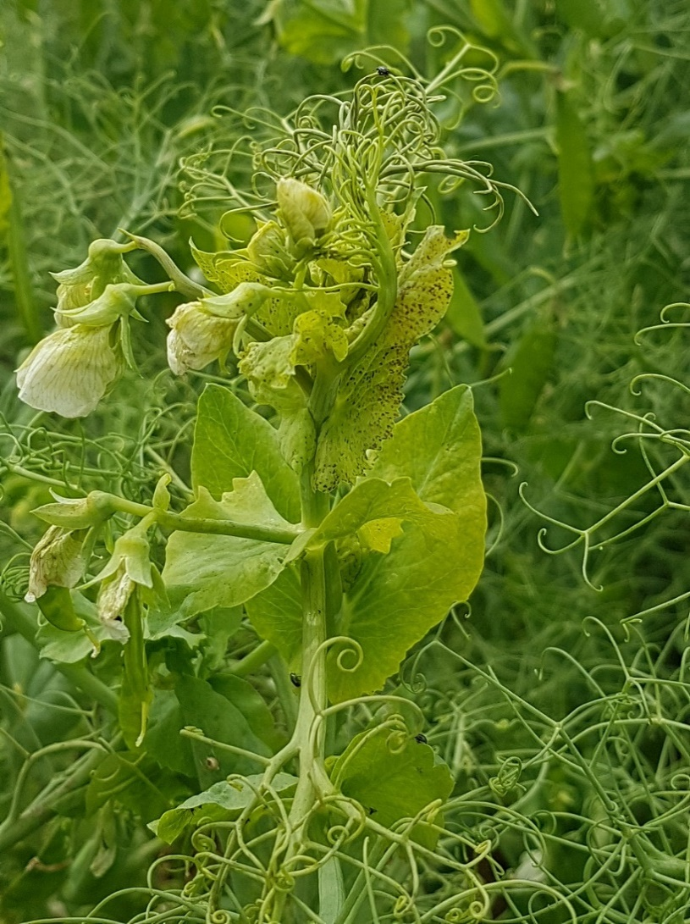
Main aphid borne viruses
Pea Enation Mosaic Virus (PEMV) – persistent – pea aphid, potato aphid and peach potato aphid
Turnip Yellows Virus (TuYV) – persistent – peach-potato aphid, wheat aphids
Pea Streak Virus (PeSV) – non-persistent – pea aphid

Slide 4
Virus survey 2019
Site | Location | Variety | HTS result | TuYV Result Estimate | PEMV1 Result Estimate | SbDV Result Estimate
9 | East Riding | Swallow | TuYV | 1.71 | nt | nt
10 | Ulceby | Ebba | TuYV | 6.76 | nt | nt
11 | Chatteris | Vidor | TuYV | 60.62 | nt | nt
12 | Langtoft | Amalfi | TuYV PEMV2 | 9.7 | 0.85 | nt
13 | Louth | Realm | TuYV PEMV2 | 21.8 | 0 | nt
14 | Market Weighton | Ashton | TuYV PEMV2 SbDV | 93.33 | nt | 1.71
15 | Perth | TBC | TuYV PEMV1 PEMV2 SbDV | 2.64 | 0.85 | 4.53
16 | Wainfleet | Oasis | TuYV PEMV1 PEMV 2 PEMV Sat | 8 | 3.72 | nt
17 | Stoneleigh | Vidor/Ambassador | TuYV | 6.98 | nt | nt
18 | Bedingfield | Kimberley | TuYV PEMV Sat | 93.33 | nt | nt
19 | Langton | Oasis | TuYV PEMV 2 | 80.01 | nt | nt
20 | Chirnside Borders | Boogie | TuYV PEMV1 PEMV 2 PEMV Sat | 14.29 | 30.09 | nt

Slide 5
Aphid control
Pirimicarb
1 application only, maximum dose rate 0.28 kg/ha, 7 day HI
Apply between 1 May and 31 August and not before GS 51 (first flower buds visible)
Use for large colonies (pea aphid, threshold 15% plants infected)
Flonicamid (Teppeki – EAMU)
1 application only, maximum dose rate 140 g/ha, 14 day HI
Must not be applied during flowering
Good option for early control of virus (peach potato aphid)
Thiacloprid
2 applications, maximum dose 0.4 l/ha, 7 day HI
Good option for early control of virus (peach potato aphid)

Slide 6
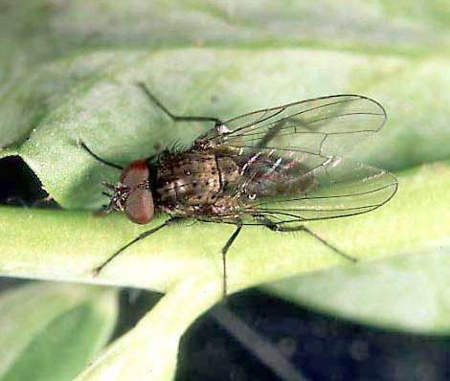
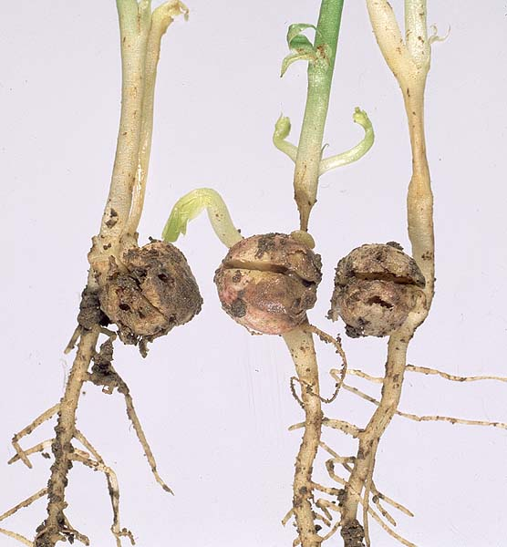
Bean Seed Fly
Wide host range, affecting over 40 plant species
Flies are associated with soils containing high levels of organic material such as farmyard manure and plant debris
Flies prefer recently cultivated soil
Damage is caused by seed and stem tunnelling by larvae
Reduces establishment (up to 60% in worst cases)

Slide 7
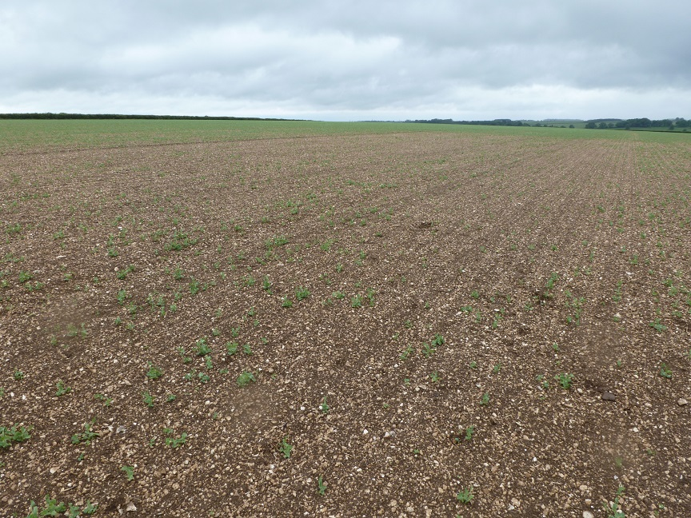
2019 BSF survey
Attractant traps to monitor peak pest presence
Sowing timing both general and related to period following cultivation
Cultivation techniques – drill type/ direct drilling/ min-till/ drilling depth
Improve knowledge of life-cycle
Determine foot rot risk in BSF damaged plants

Slide 8
BSF peak activity
Number of bean seed fly adults recorded in traps
Appeared to be one main peak of activity followed by smaller ones at different intervals depending on location

Slide 9
Damage related to pest activity
Lincolnshire and Yorkshire sites combined results

Slide 10
Cultivation methods – plant damage
All treatments apart from the control in Lincolnshire had autumn cultivations only
Spring cultivation for the control was 11 days prior to drilling
F1 to F3 were drilled 23 April 2019 (23 days before 1st peak)
Control was drilled 26 April 2019 (20 days before 1st peak)

Slide 11

Summary
Differences in timing of peak activity depending on location
Drilling period within the 10 days before and after peak might be at greater risk
Spring cultivations close to drilling date may create higher risk
There is no strong correlation between damage and foot rot in 2019 data but requires further work
There was an indication in Lincolnshire that drilling depth affected damage
There was no evidence that drill type or rolling affected damage

Slide 12

BSF – Sceptre Plus

Slide 13
Downy mildew – crop protection
Peas:
  Wakil XL – restricted.
  Alternatives?
  Foliar treatment: Revus (VP only).
Beans:
  No seed treatment.
  SL567A.

Slide 14
Biostimulants
2018
2019
Seed treatments containing phosphites: Take Off and MultiMax GPA
Foliar treatments containing phosphites: Phorce (applied at 2nd node and flowering)

Slide 15
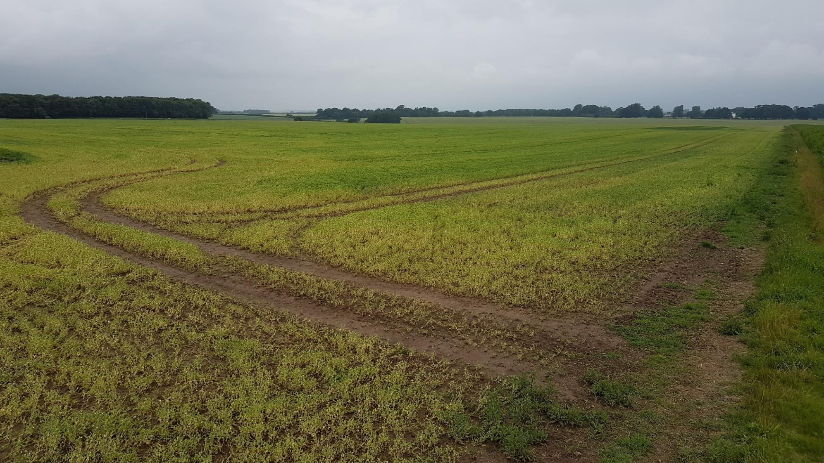
Pea Foot Rots

Slide 16
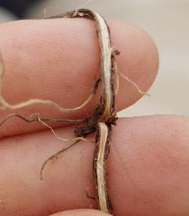
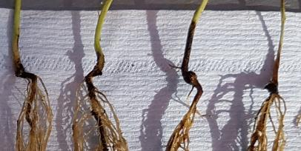
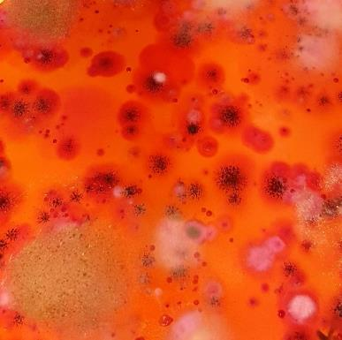
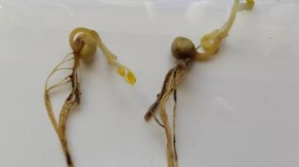
Foot rot pathogens
Fusarium solani – red vascular tissue
Didymella pinodella – black stem base
Aphanomyces euteiches – soft roots, honey coloured
Soil test
  New from 1st March 2020: Combined test for all three pathogens
  Colony numbers (Fusarium and Didymella) and disease severity seedling (Aphanomyces) – risk factor individually and combined

Slide 17
Variety trials 2019
Angus
Severe infection
Lincolnshire
Strong infection

Slide 18
Alternative seed treatments - glasshouse
Product I (2018) – pot tests
d
c
bc
b
ab
a
a
ab
ab
a
No effect on Aphanomyces

Slide 19
Alternative seed treatments - field
Product I (2019) – combining peas
Four products, four field trials performed, results not consistent.

Slide 20
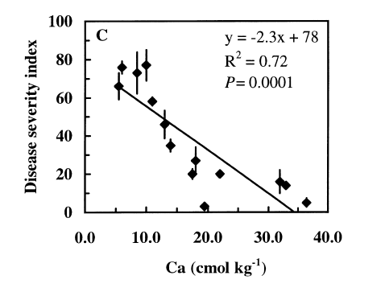
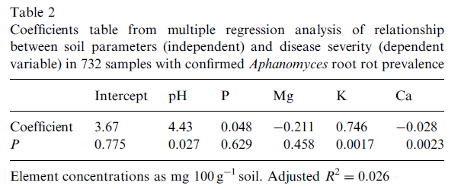
Calcium
Persson and Olsson (2000) Soil Biology & Biochemistry 32, 1141-1150
Heyman et al (2007) Soil Biology & Biochemistry 39, 2222-2229

Slide 21
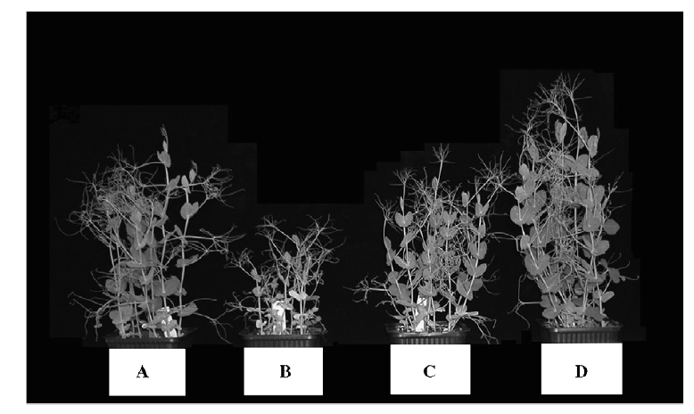
Gypsum
Healthy soil
Aphanomyces
Limestone
CaCO₃
Gypsum
CaSO₄
Heyman et al (2007) Soil Biology & Biochemistry 39, 2222-2229

Slide 22
Gypsum – Glasshouse trial

Slide 23
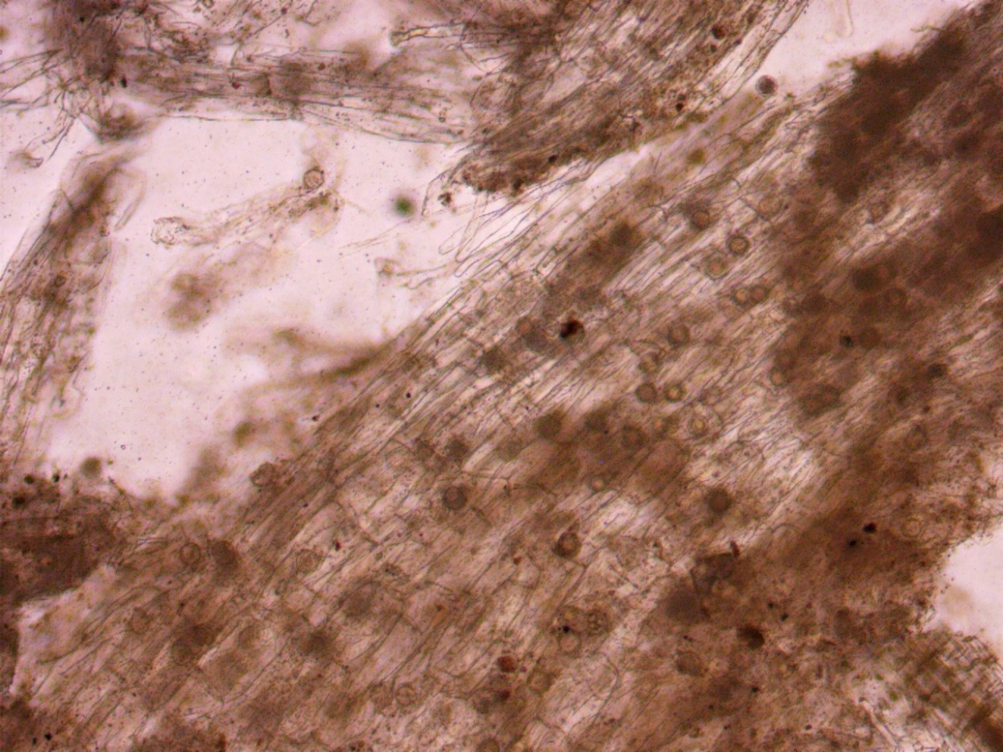
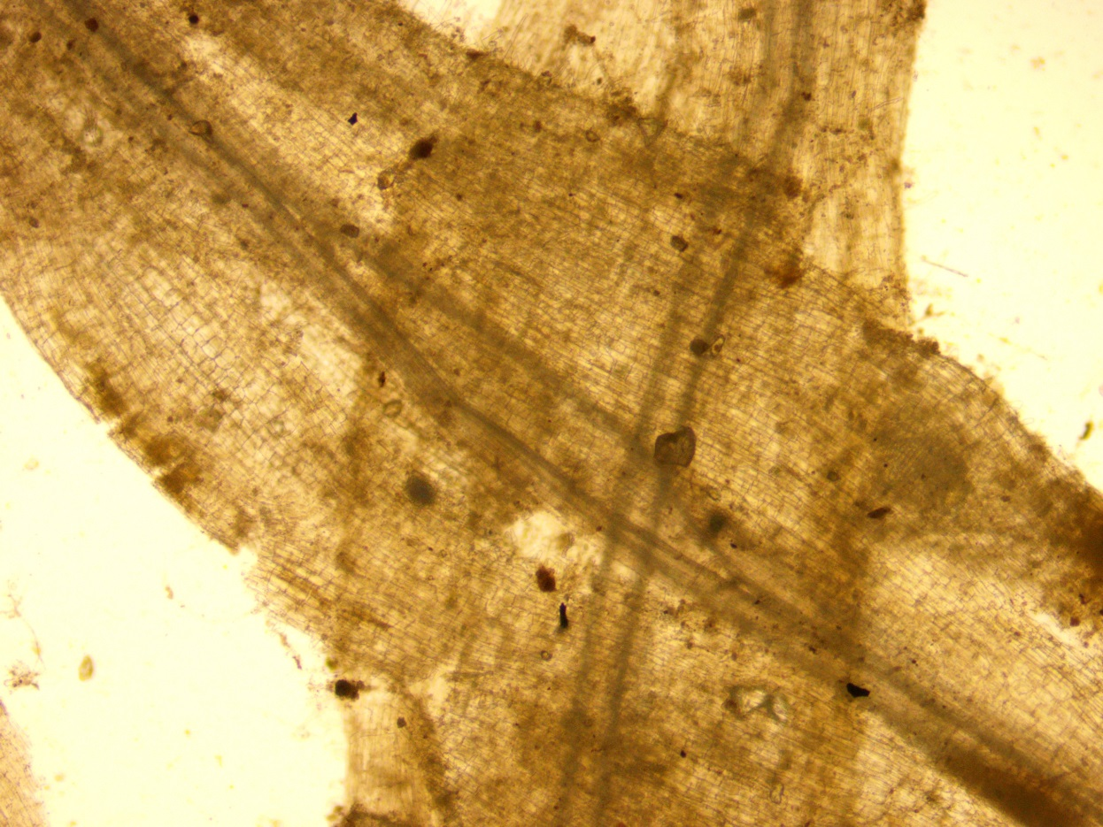
Gypsum – Glasshouse trial
Control
2000ppm

Slide 24
Fusarium in fields 2018

Slide 25
Foot rot in fields 2019
Foot rot severity in the field explained by (45%)
  Abundance of Fusarium spores
  Abundance of Didymella spores
  Magnesium in soil (clay related?)
  Reduced by higher amounts of organic matter

Slide 26
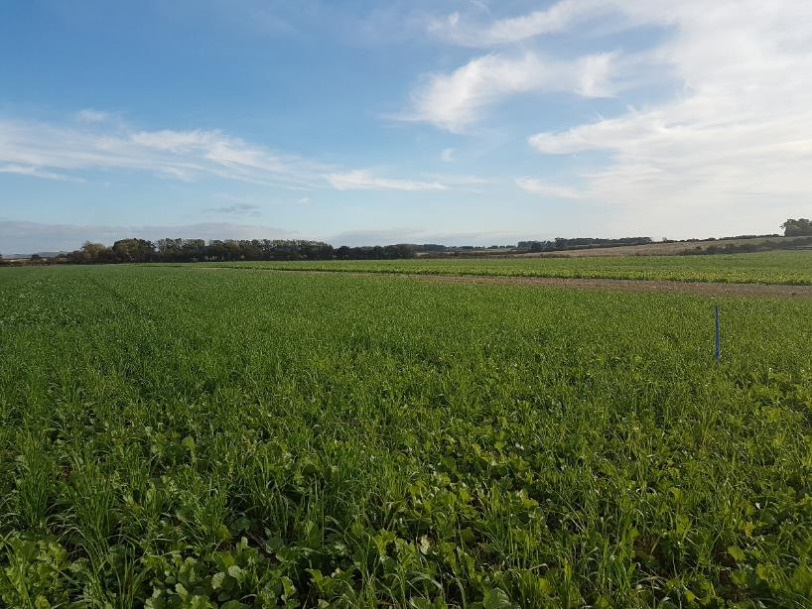
Thank you
HMC
Bruce Farms
Yorkshire Peas
Stemgold Peas
Fera
Warwick Crop Centre
AHDB
lea@pgro.org
07583 524188

